Slide 1
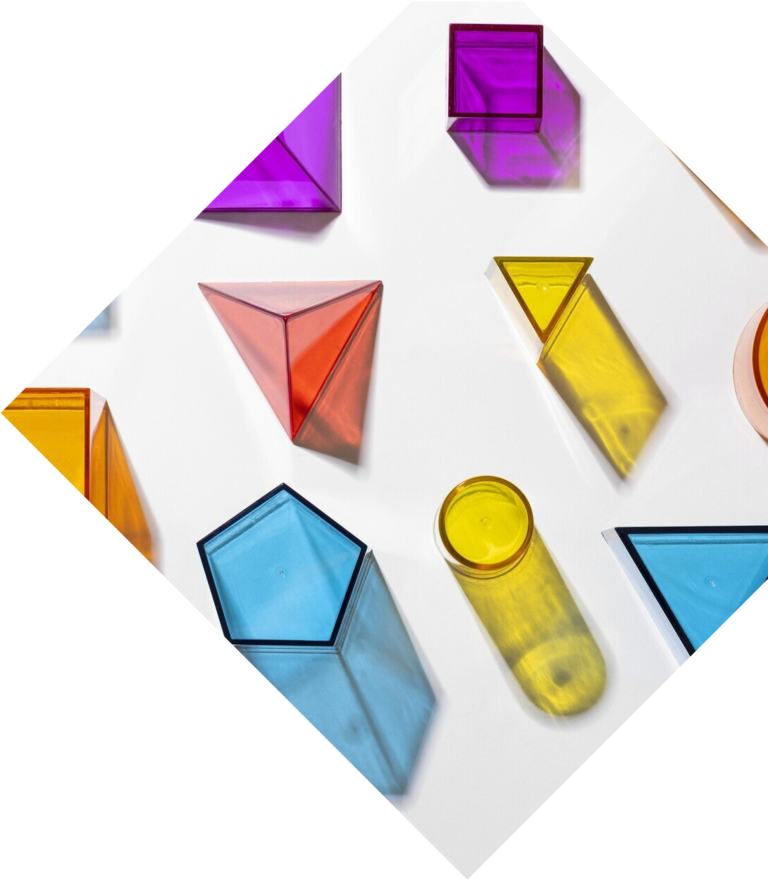
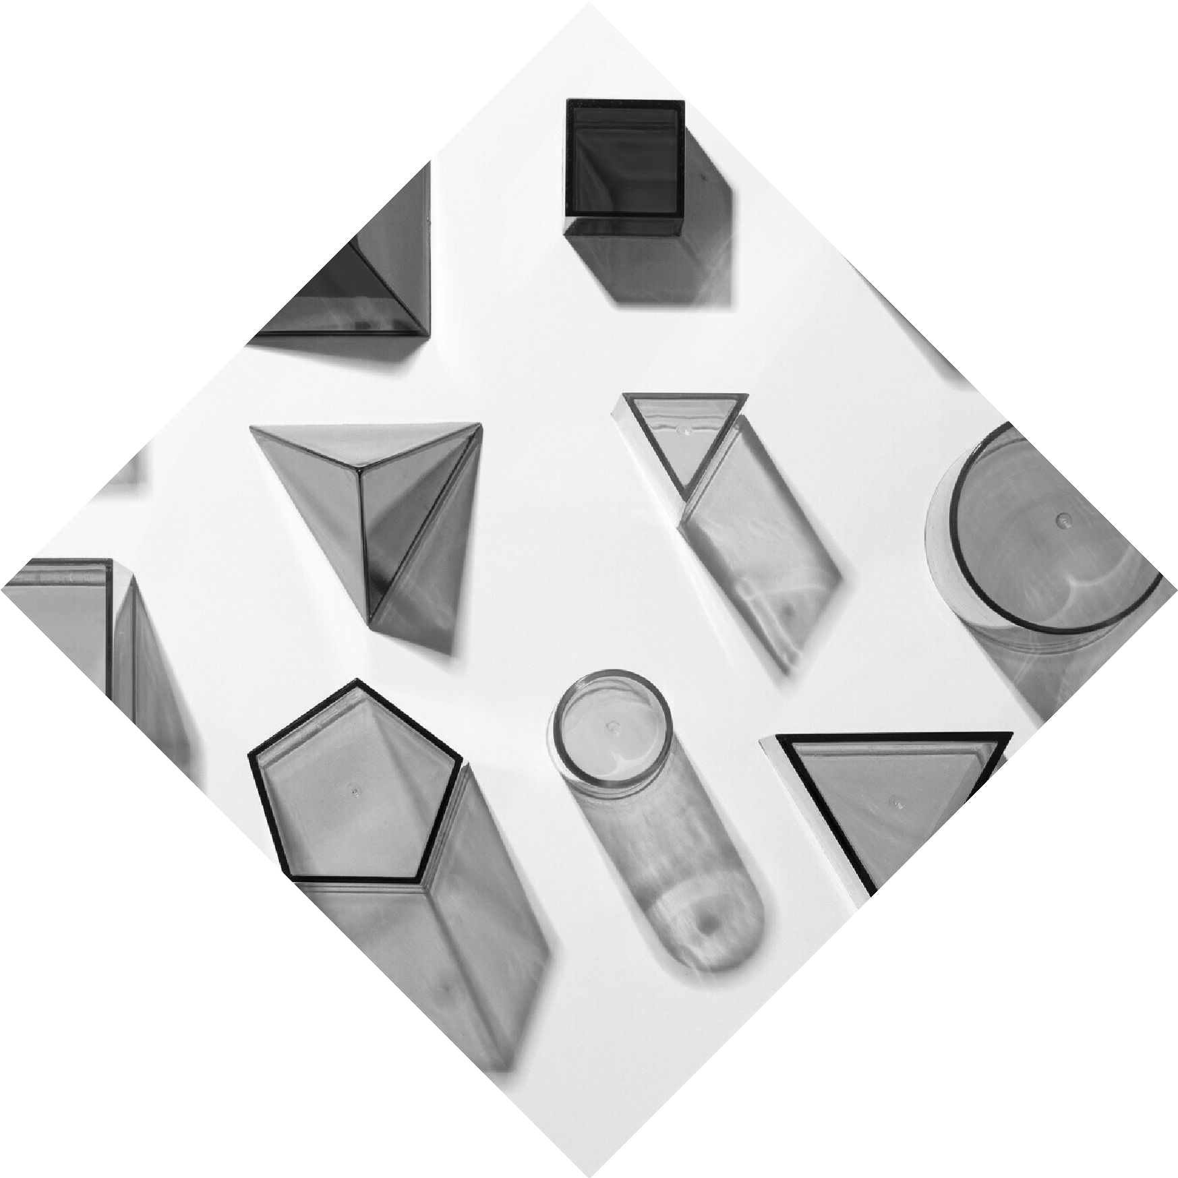
Optimization of Two-Dimensional Polygon Packing Using Genetic Algorithms
and
Advanced Heuristic Methods
Author: Coral Harel
Supervisor: Dr. Miri Weiss Cohen

Slide 2
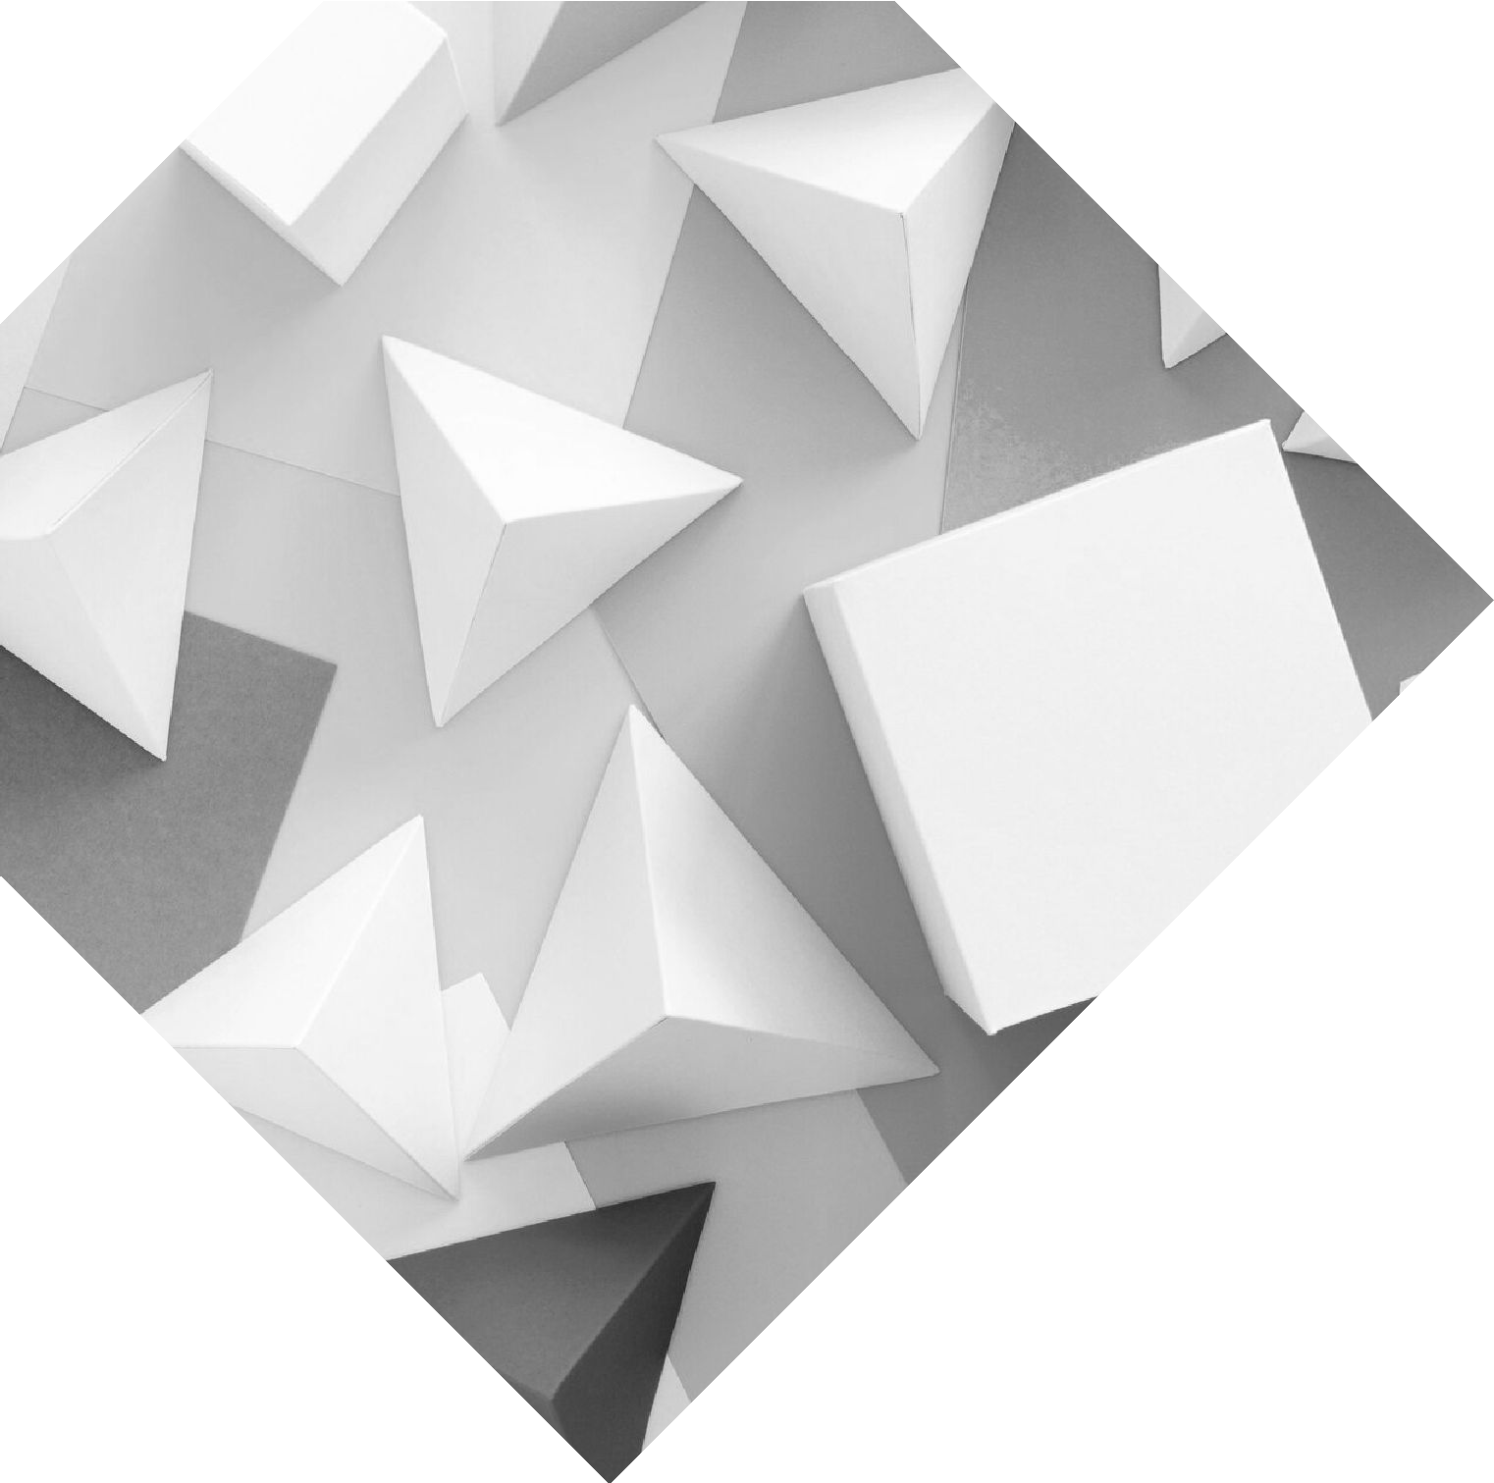
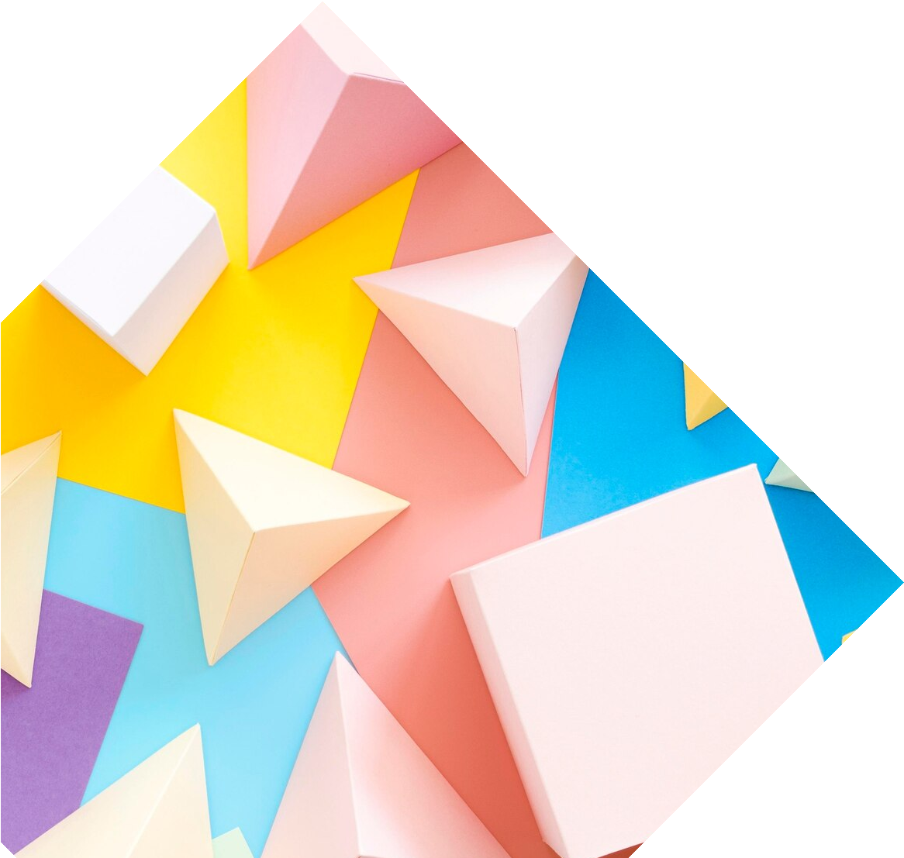
Introduction
polygon packing problem
NP-hard problem
The importance in real-world applications

Slide 3

The Polygon
Packing Problem
Objective:
Arrange polygons in a bin
Constraints:
No overlap, remain within bin boundaries
Goal:
Maximize space utilization

Slide 4

Why Use Genetic Algorithms?
Natural selection process
Evolutionary optimization for complex problems

Slide 5




Genetic Algorithms Overview
Initialize population
Fitness function based on polygon arrangement
Crossover to combine parent solutions
Mutation to introduce variation

Slide 6
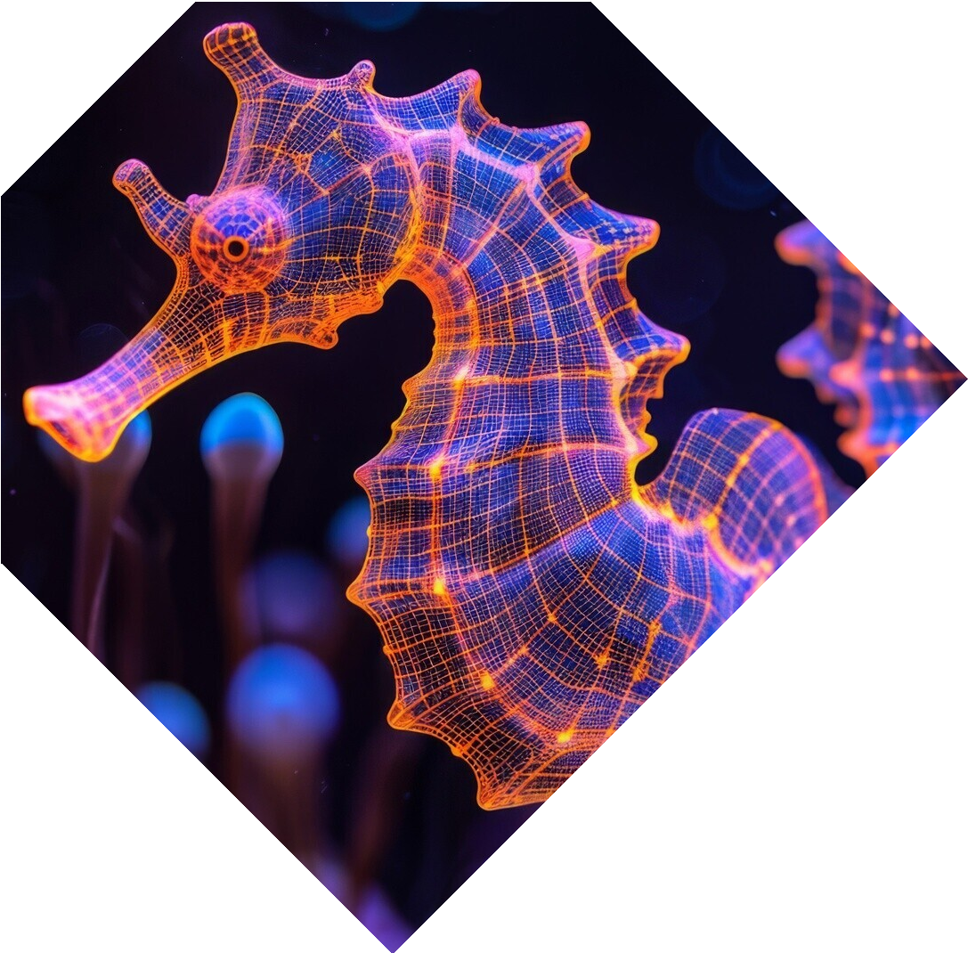
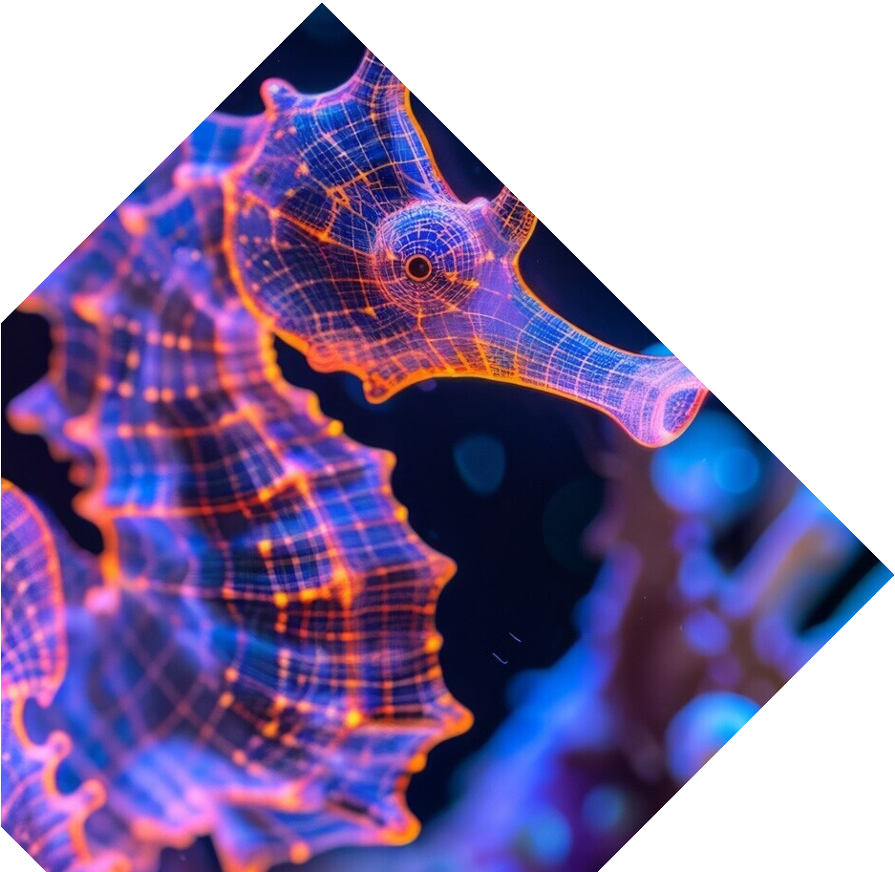
Mutation and Crossover
Mutation:
Random shifts and rotations
Crossover:
Combining parent solutions
Ensuring diversity in solutions

Slide 7
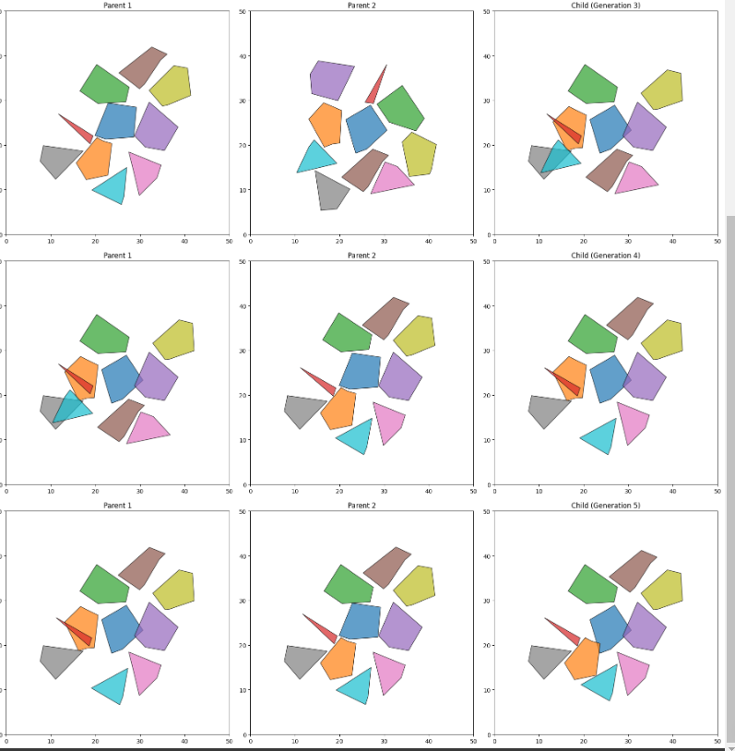

Slide 8

Heuristic Methods
DJD Heuristic:
Sorting by area and perimeter
Bottom-Left-Fill:
Prioritize lower-left corner placement
Center-Focus: Arrange polygons around the center of the bin

Slide 9
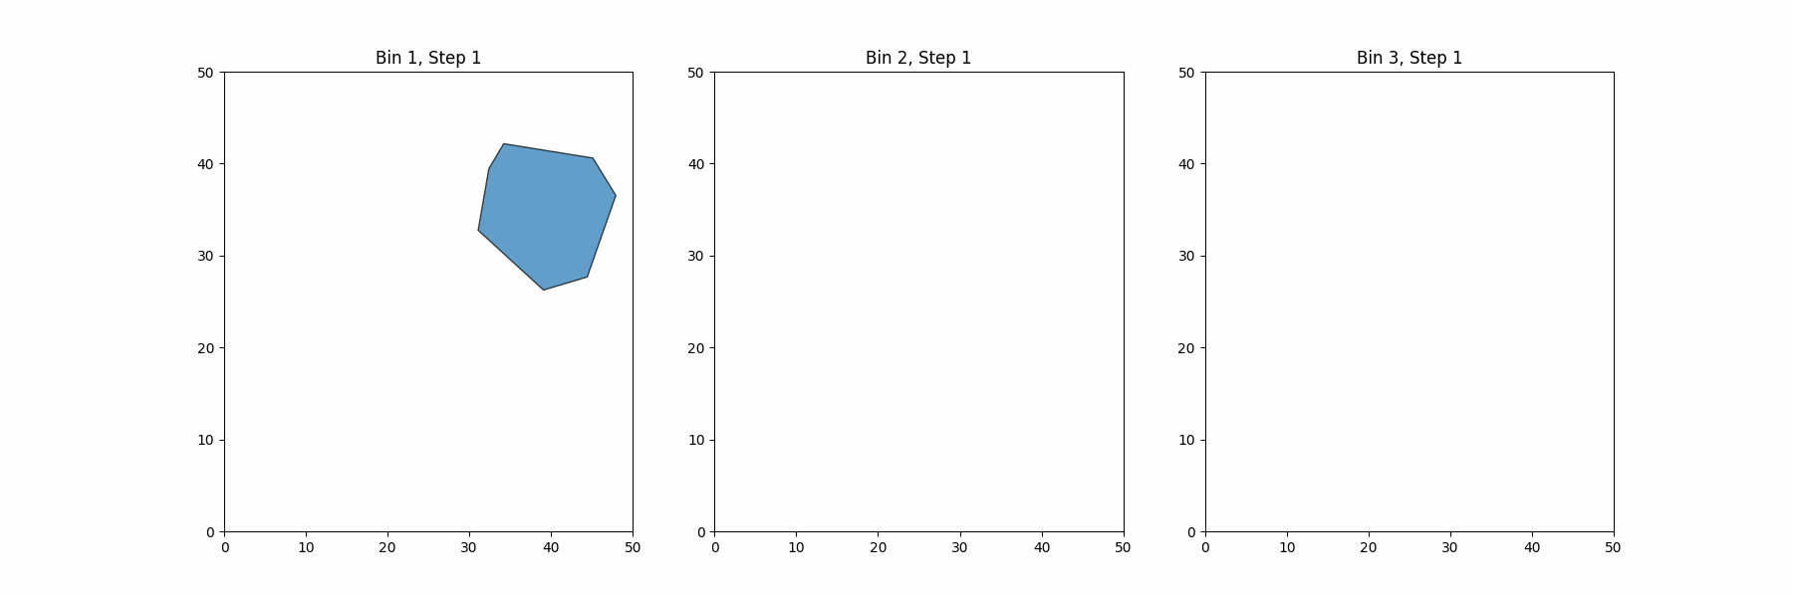
DJD Heuristic (Decreasing Justified Distance)

Slide 10
Bottom-Left Fill

Slide 11
Center Focus Fill

Slide 12



Fitness Function
Optimizes space usage and encourages central positioning

Slide 13
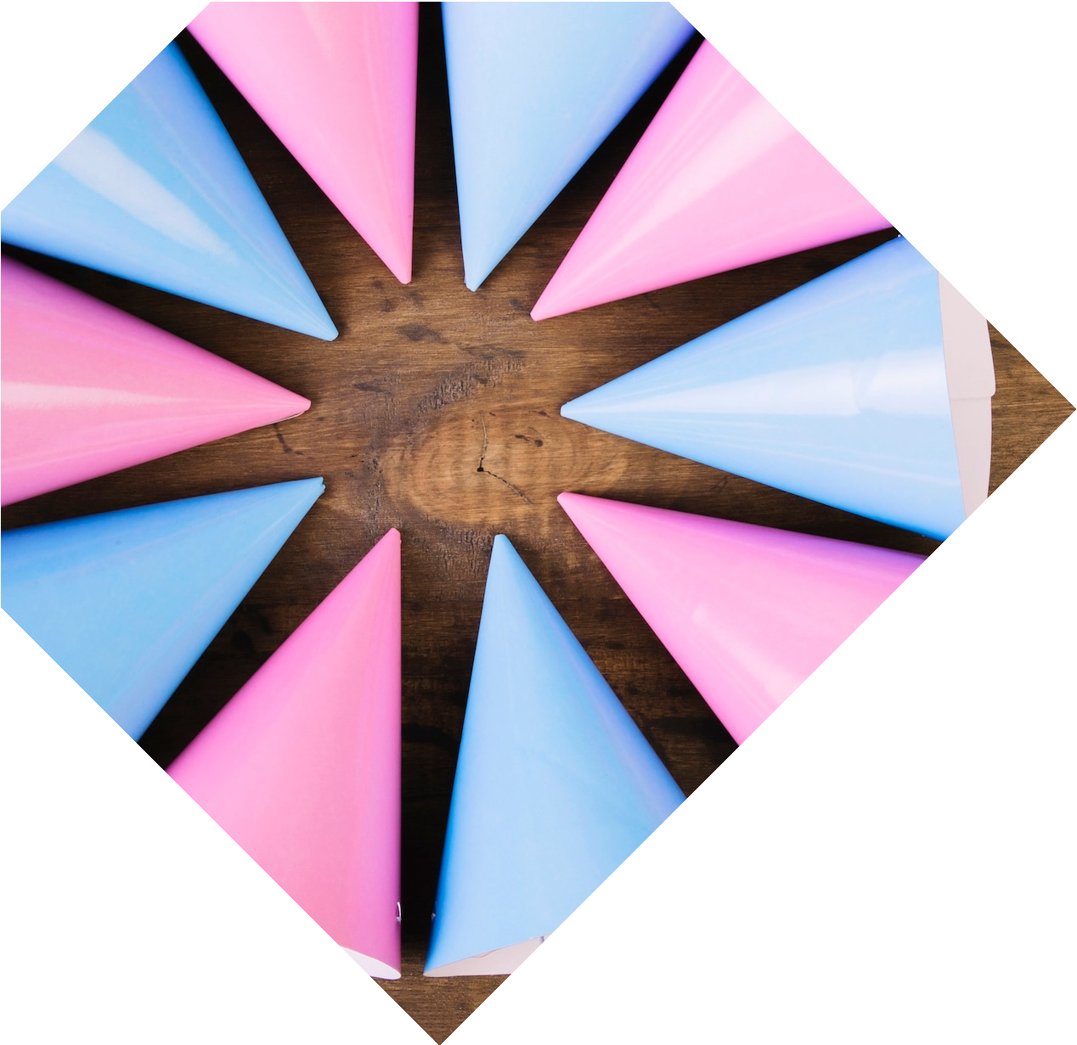
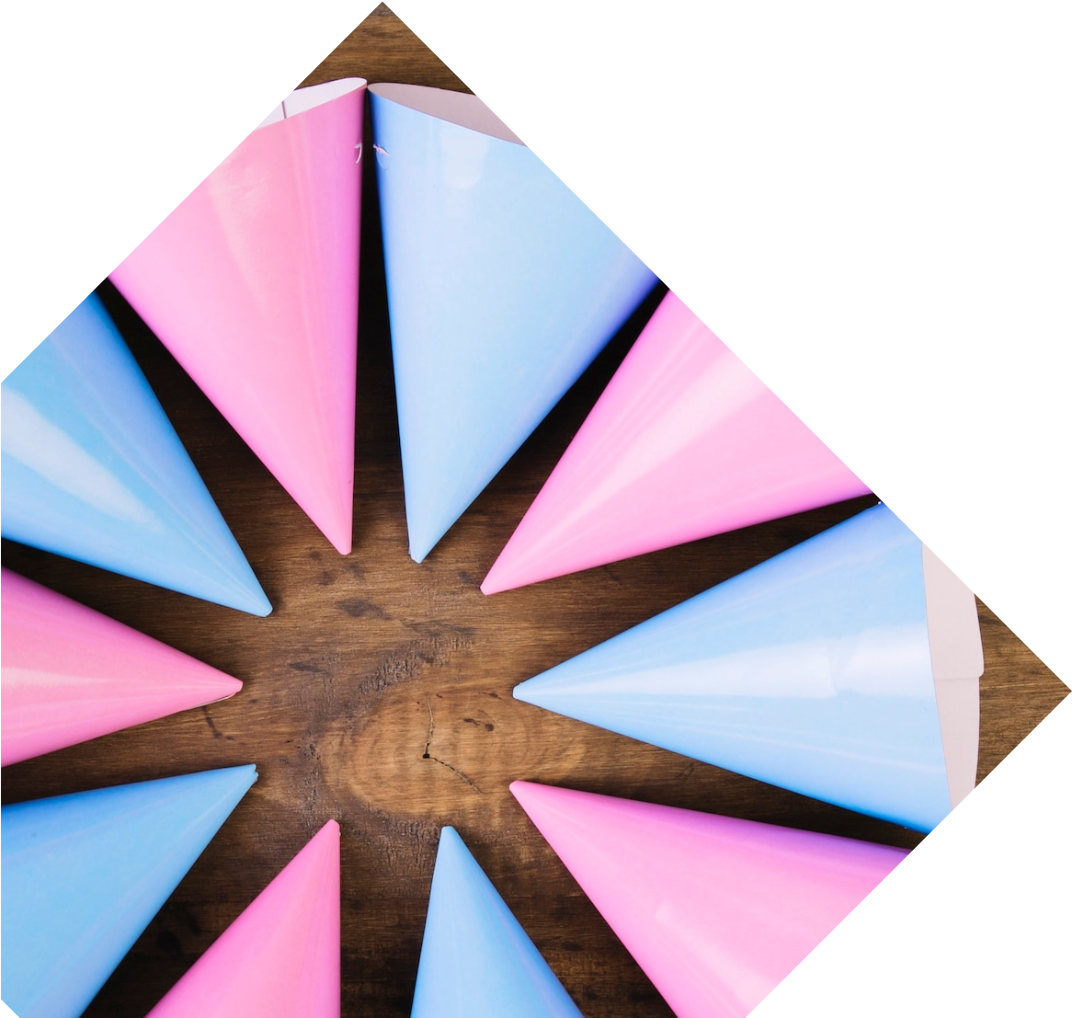
Challenges
Irregular shapes, maximizing space
Overlap issues
Slow convergence
Balancing polygon placement and ﬁtness

Slide 14

Conclusions
Eﬀective of Genetic Algorithm
Future improvements and directions

Slide 15
Thanks!
Do you have any questions?

